Slide 1
Blacktown Chinese Christian Church
Welcome to Our English Service 01.12.2024
English Service 9:45 – 11:00 am
Worship Songs: Passage: Speaker: Topic: Response Song: Announcements and Closing Prayer Benediction
Joy To The World Remembrance In Christ Alone Revelation 2:1-7 TBA TBA TBA

Slide 2
BCCC english service

Slide 3

Please keep all phones on silent

Slide 4
Joy To The World
CCLI Licence No: 5485849

Slide 5
Verse 1
Joy to the world, the Lord has come
Let earth receive her King
Let every heart prepare Him room
And heaven and nature sing, and heaven and nature sing

Slide 6
Verse 1
And heaven, and heaven and nature sing

Slide 7
Verse 2
Joy to the earth, the Savior reigns
Let men their songs employ
While fields and floods, rocks, hills, and plains
Repeat the sounding joy, repeat the sounding joy

Slide 8
Verse 2
Repeat, repeat the sounding joy

Slide 9
Verse 3
No more let sins and sorrows grow
Nor thorns infest the ground
He comes to make His blessings flow
Far as the curse is found, far as the curse is found

Slide 10
Verse 3
Far as, far as the curse is found

Slide 11
Verse 4
He rules the world with truth and grace
And makes the nations prove
The glories of His righteousness
And wonders of His love, and wonders of His love

Slide 12
Verse 4
And wonders, wonders of His love

Slide 13
Remembrance
. CCLI Song number: 7102398

Slide 14
Verse 1
I take the bread of life
Broken for all my sin
Your body crucified
To make me whole again

Slide 15
Verse 2
I will recall the cup
Poured out in sacrifice
To trade this sinner's end
For Your new covenant

Slide 16
Chorus
Hallelujah
I'll live my life in remembrance
Hallelujah
Your promise I won't forget

Slide 17
Verse 3
I'll walk salvation's road
With fear and trembling
Your way borne as my own
As Christ is formed in me

Slide 18
Chorus
Hallelujah
I'll live my life in remembrance
Hallelujah
Your promise I won't forget

Slide 19
Post-Chorus
If ever I should lose my way
If ever I deny Your grace
Remind me of the price You paid

Slide 20
Post-Chorus
Hallelujah
I'll live in remembrance

Slide 21
Bridge
You've been so, so good to me
You've been so, so good to me
Oh to think where I would be
If not for You, if not for You (x3)

Slide 22
Post-Chorus 2
As far as heights reach from the depths
As far as east is from the west
So far Your grace has carried me

Slide 23
Post-Chorus 3
Until I see You face to face
Until at last I've won my race
Remind me You're not finished yet

Slide 24
Outro
Hallelujah
Hallelujah
Hallelujah
I'll live in remembrance

Slide 25
In Christ Alone
Keith Getty, Stuart Townend ©2001 Thankyou Music (Admin. by SHOUT! Music Publishing Australia) CCLI Licence No. 5485849. CCLI Song number: 3350395

Slide 26
Verse 1
In Christ alone my hope is found
He is my light, my strength, my song
This Cornerstone, this solid Ground
Firm through the fiercest drought and storm

Slide 27
Verse 1
What heights of love, what depths of peace
When fears are stilled, when strivings cease
My comforter, my All in All
Here in the love of Christ I stand

Slide 28
Verse 2
There in the ground His body lay
Light of the world by darkness slain
Then bursting forth in glorious day
Up from the grave He rose again

Slide 29
Verse 2
And as He stands in victory
Sin’s curse has lost its grip on me
For I am His and He is mine
Bought with the precious blood of Christ

Slide 30
Verse 3
No guilt in life, no fear in death
This is the power of Christ in me
From life’s first cry to final breath
Jesus commands my destiny

Slide 31
Verse 3
No power of hell, no scheme of man
Can ever pluck me from His hand
Til He returns or calls me home
Here in the power of Christ I’ll stand

Slide 32
Outro
Till He returns or calls me home
Here in the power of Christ I’ll stand
Here in the power of Christ we stand

Slide 33
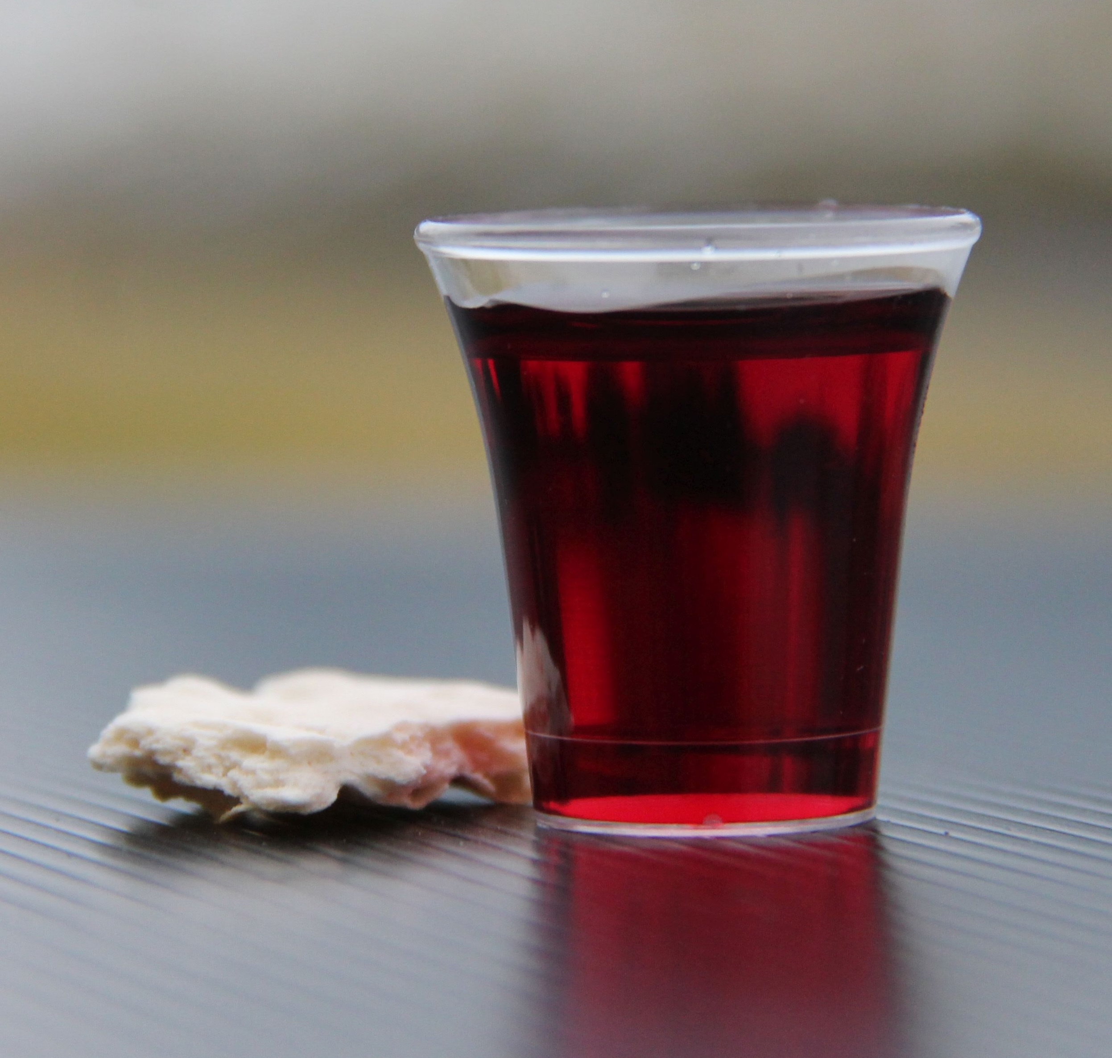
Holy Communion

Slide 34

Bible reading

Slide 35
Bible reading: Revelation 2:1-7
“To the angel of the church in Ephesus write:
These are the words of him who holds the seven stars in his right hand and walks among the seven golden lampstands. ² I know your deeds, your hard work and your perseverance. I know that you cannot tolerate wicked people, that you have tested those who claim to be apostles but are not, and have found them false.

Slide 36
Bible reading: Revelation 2:1-7
³ You have persevered and have endured hardships for my name, and have not grown weary.
⁴ Yet I hold this against you: You have forsaken the love you had at first.

Slide 37
Bible reading: Revelation 2:1-7
⁵ Consider how far you have fallen! Repent and do the things you did at first. If you do not repent, I will come to you and remove your lampstand from its place. ⁶ But you have this in your favor: You hate the practices of the Nicolaitans, which I also hate.

Slide 38
Bible reading: Revelation 2:1-7
⁷ Whoever has ears, let them hear what the Spirit says to the churches. To the one who is victorious, I will give the right to eat from the tree of life, which is in the paradise of God.

Slide 39
Announcements

Slide 40





Account name: Blacktown Chinese Christian Church
Account number: 4216 50263
Offering
BSB: 112 - 879
Please put in "offering" as the reference
The offering box is available at the back of the hall

Slide 41
Prayer points

Slide 42
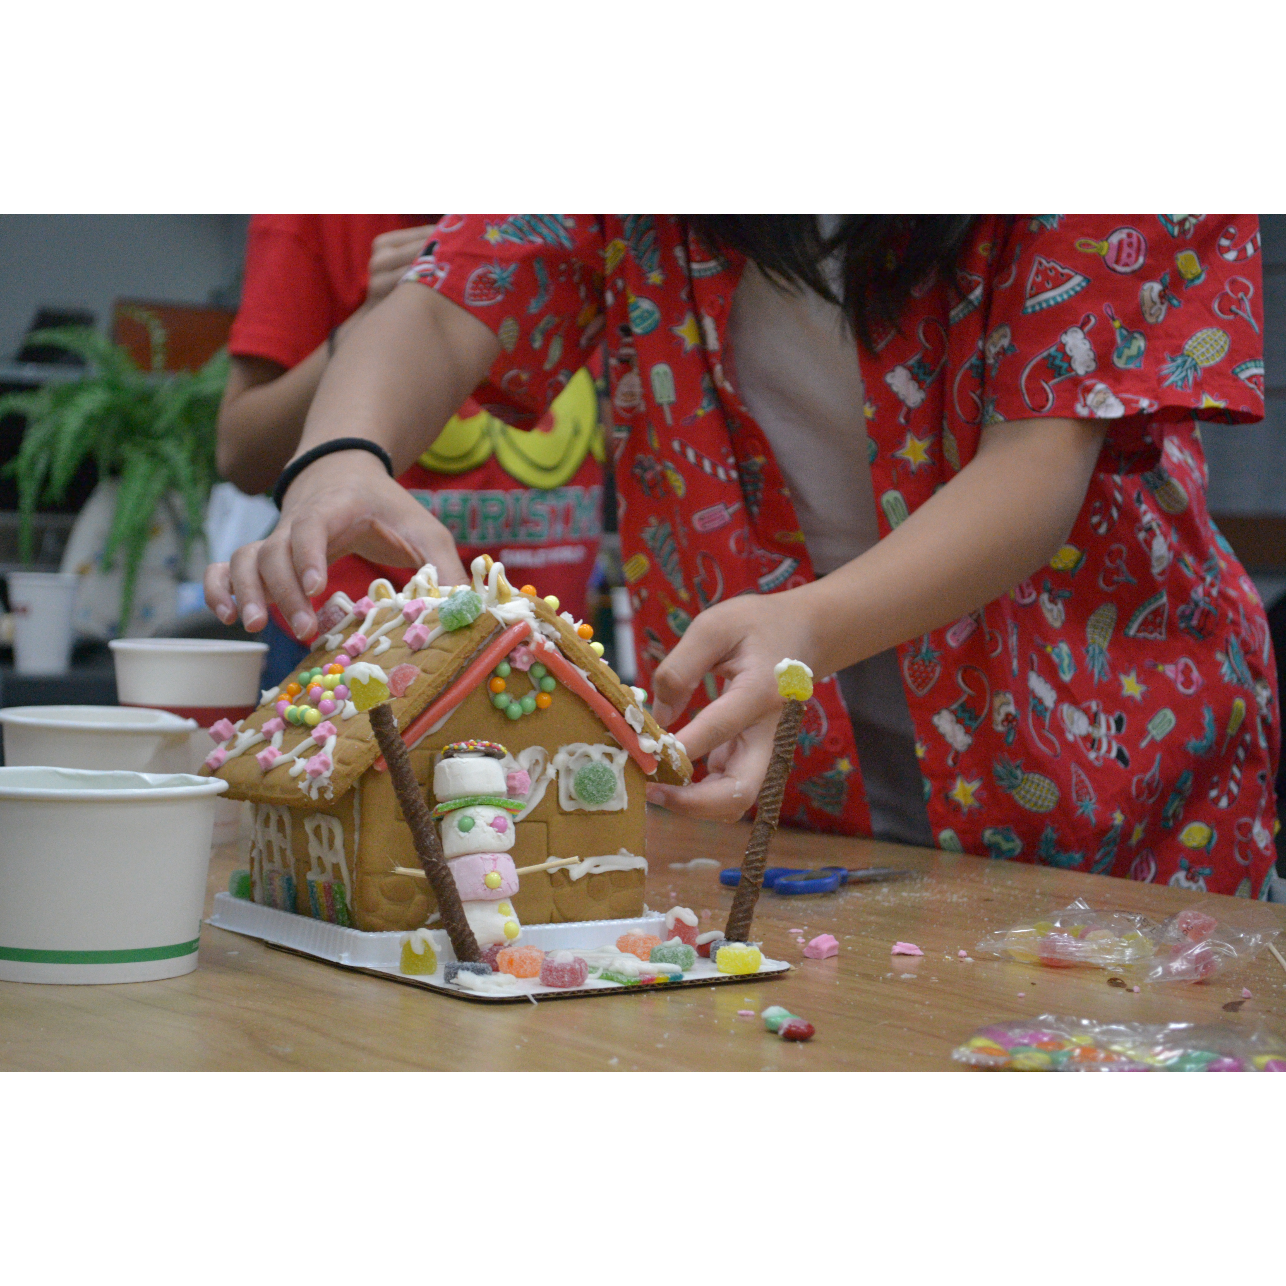
Mingle time!

